Slide 1
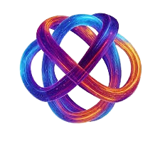
Problem 3:
Securing the Quantum Channel:
Quantum Key Distribution (QKD)
Alexandria Quantum
Hackathon II

Slide 2
Team Members
  Esraa Mohamed Mahmoud Hussien
  Mo'men Mohamed Ramadan Mohamed
  Mohammed Ahmed Mohammed El-said
  Aivy Moataz bella Mostafa Kamel
  Shaheen Abdelrahman Maher Ibrahim Karam
Mentors:
  Mahmoud ElShimi
  Raghad Nawwar
  Mohamed Helmy

Slide 3
Outlines:
  Introduction
  BB84 Implementation Example
  Problem Statement
  Quantum Approach
    QKD Implementation of Simulation
    QBER without Eve vs. with Eve
    Noise experiment
    Reconciliation and Privacy Amplification
    Security threshold
    Limitations
  Conclusion

Slide 4
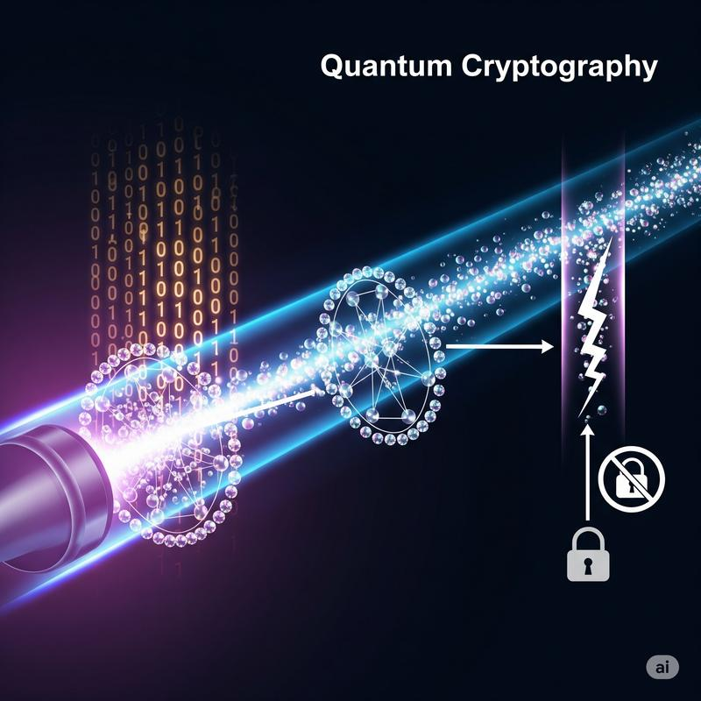
1. Introduction
Classical encryption relies on computational hardness.
We need secure communication where eavesdropping can be detected. So, we use BB84 (QKD protocol).

Slide 5
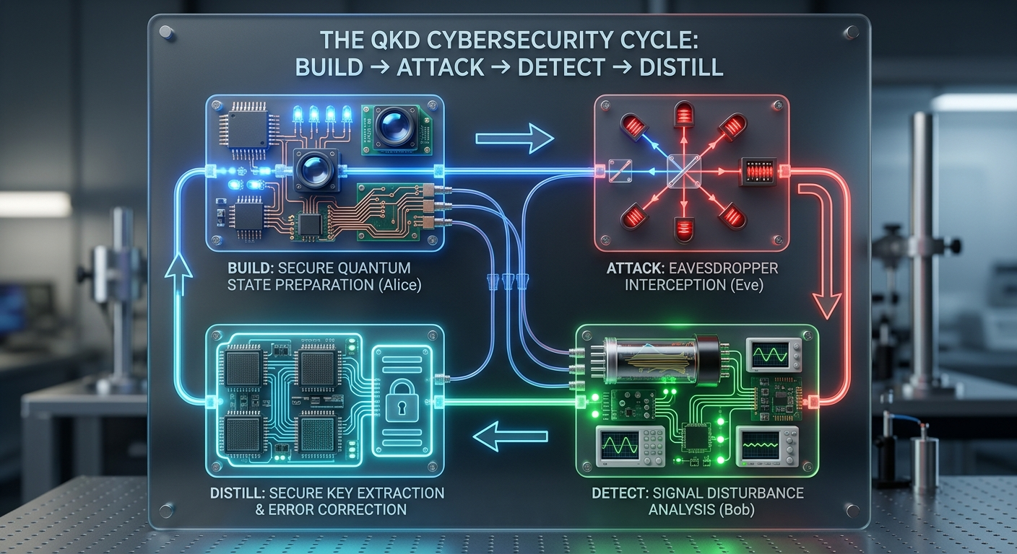
2. Problem Statement
Build → Attack/Noise → Detect → Distill
Building and stress-testing a full QKD pipeline to securely exchange keys, detect eavesdroppers, and distill absolute cryptographic secrecy.

Slide 6
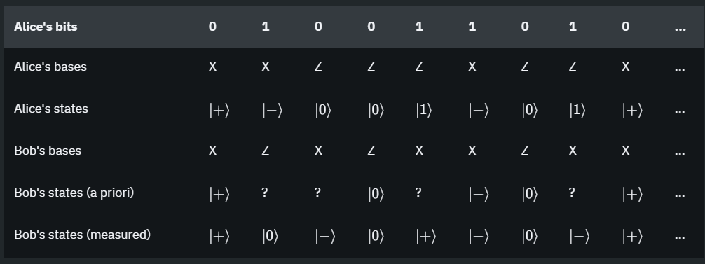
3. BB84 Implementation Example
Figure 1. BB84 without Eve

Slide 7
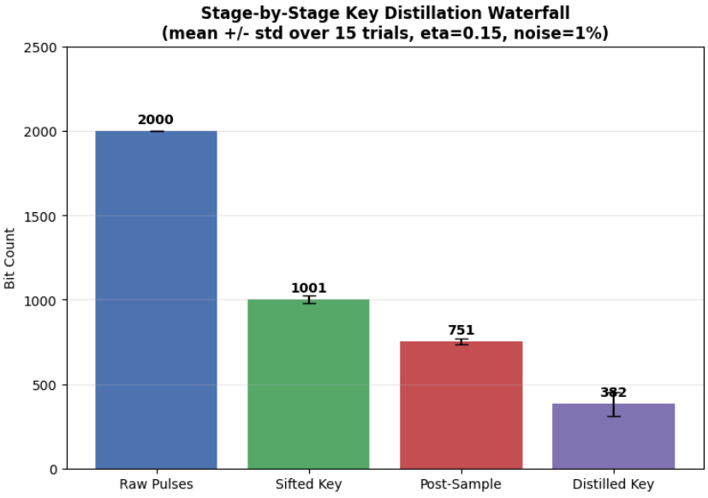
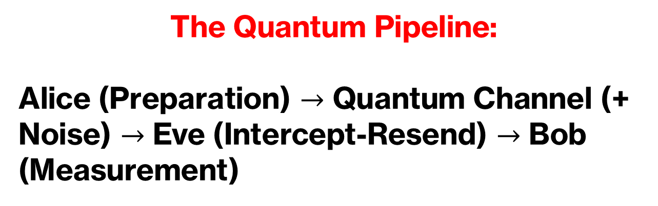

4. Quantum Approach
I. QKD Implementation of Simulation
The Quantum Pipeline:
Alice (Preparation) $→$ Quantum Channel (+ Noise) $→$ Eve (Intercept-Resend) $→$ Bob (Measurement)
Environment: Qiskit AerSimulator
Block Size: $N=2000$ qubits / trial
Figure 2. Details the lossy reduction from 2000 raw pulses to 382 secure key bits.

Slide 8

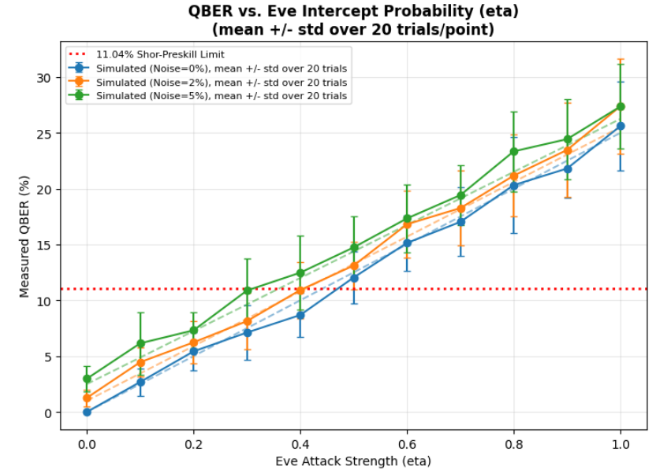
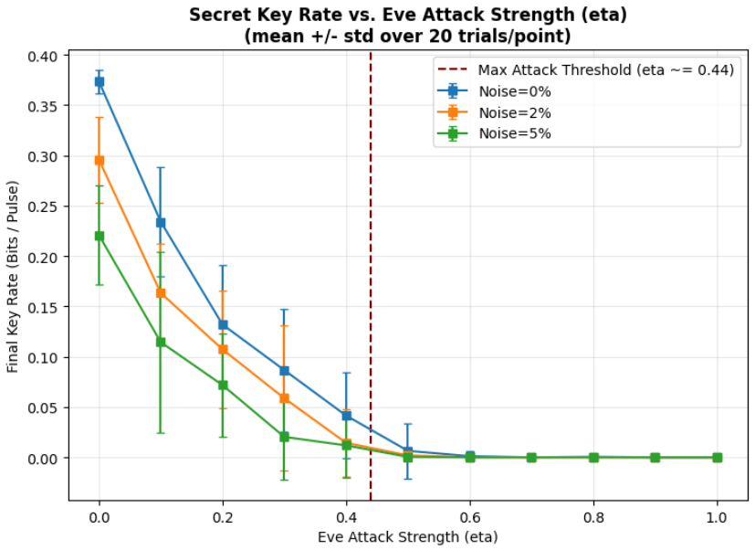
II. QBER without Eve vs. with Eve
Figure 3. Shows error rate rising with Eve's attack strength and crossing the 11.04% threshold.
Figure 4. Illustrates key generation speed.

Slide 9
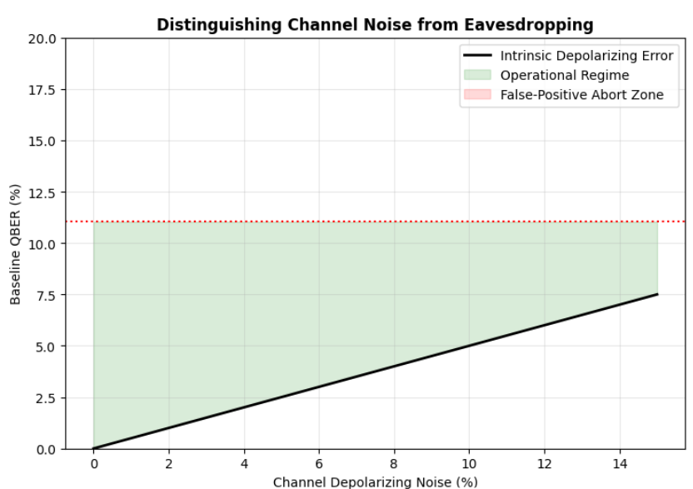
III. Noise experiment
Figure 5. Maps the safe green region where noise stays below the security threshold.

Slide 10
IV. Reconciliation and Privacy Amplification
From Sifted Key to Secure Key
Error Reconciliation corrects remaining key mismatches to ensure Alice and Bob share identical keys. Privacy Amplification then shrinks the key to completely eliminate any partial information intercepted by Eve.
Goal:
Correct the key → Reduce information leakage → Obtain a secure final key

Slide 11
VI. Security Threshold
R = 1 – 2h(Q)
Shor–Preskill secret key rate • R ∈ [0, 1]
What is h(Q)?
Limitations
1. Photon Number Splitting (PNS): multi-photon pulses leak info without raising QBER
2. Channel loss & distance: loss caps range to ~100–200 km of fiber
3. Detector side-channels: blinding & time-shift attacks on real hardware
4. Finite-key effects: real finite keys fall short of asymptotic proofs
5. Authentication requirement: classical channel needs a pre-shared secret
6. Key rate vs. distance tradeoff: more correction & distance = lower final key rate
Binary Shannon entropy – the fraction of the raw key Eve could know per bit, given a channel error rate Q. It equals:
h(Q) = −Qlog₂Q – (1−Q)log₂(1−Q)
It grows with Q, eating into the final secure key rate R.

Slide 12
5. Conclusion
Eavesdropping: Increasing attack strength raises QBER and reduces the secret key rate to zero around η ≈ 0.44–0.50.
Noise: Depolarizing noise (0–5%) increases QBER and lowers key rates.
Stability: 20 trials smooth out fluctuations and improve result reliability.

Slide 13
Thank you.

